Slide 1
Food Waste Reduction at Northern Michigan University
Co-constructing Circular Economic Opportunities through University Waste to Organics Diversion Program
Presentation at
2024 Innovate Michigan Summit
Jelili Adebiyi, PhD
Department of Earth, Environment and Geographical Sciences, Northern Michigan University
Isabel Oertel
Environmental Studies and Sustainability, Biology (minor)
Northern Michigan University

Slide 2
Presentation Outline
Introduction
Methods
Results
Implications
Conclusions

Slide 3
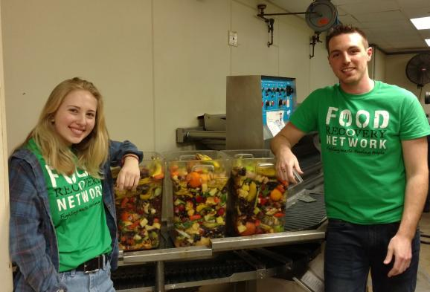
Introduction
U.S. college students generate ~110 pounds of edible food waste per student per year
Presents:
Circular opportunity for organic waste diversion for composting
Food waste reduction
Food wasted at Northern Michigan University
Knowledge gap – Reason for waste and waste reduction
Qualitatively and quantitatively explored causes of food waste at NMU restaurants to determine how to reduce it

Slide 4
Data Collection
Focus Groups:
4-8 people each
Students who lived on campus and commuting students
Reasons for food waste, waste reduction, etc.
Data-informed survey design
Survey:
Qualtrics administered
Reasons for food waste
Food waste reduction
Ongoing, but 286 responses so far

Slide 5
FINDINGS

Slide 6
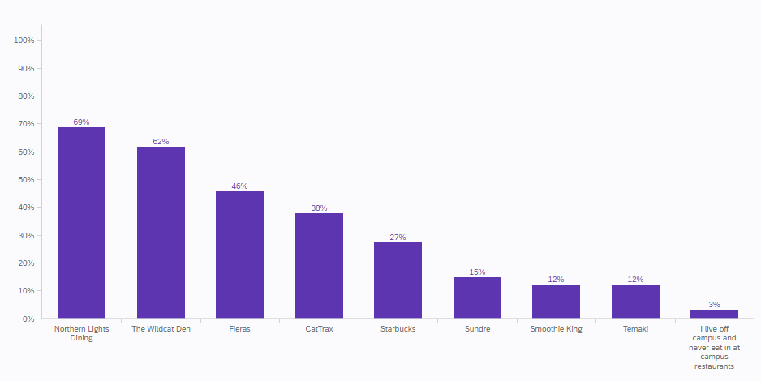
Favorite Restaurant at NMU Campus
NLD
Convenience, fast, easy
Ability to sit with friends and be social
Preference for Wildcat Den, Temaki, Fieras, Smoothie King, and Starbucks
Ability to take unfinished food to go
Perceived higher quality of the food options
Less wasting of food

Slide 7
Perception of Locations Where Students Eat Most On Campus

Slide 8
Perception of Locations Where Students Eat Most On Campus
Food Quality (NLD)
Related to pre-plated food
Quality of the food rated low, inconsistent, and repetitive
Food options not very healthy
“Whenever I used to walk in the dining hall, it was all burgers, fries, pizza – the most unhealthy food choices you could choose from except for one station–the vegan station–and I just feel like there are so many other healthy options that you can have that are so good. And we can incorporate that into our food system.”
"By the time you finish one plate, the next one is cold, and it doesn't taste as good."

Slide 9
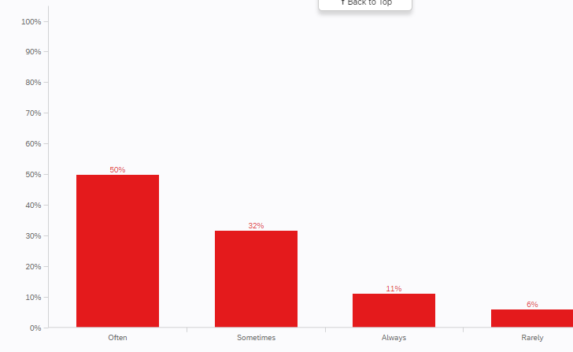
Eating Habits At NMU Facilities Other Than Northern Lights Dining
Take enough food
Majority take enough food (61%)
32% sometimes

Slide 10
Student Perception on Whether They Waste A Lot Of Food At Any NMU Dining Facility
Majority waste much food

Slide 11
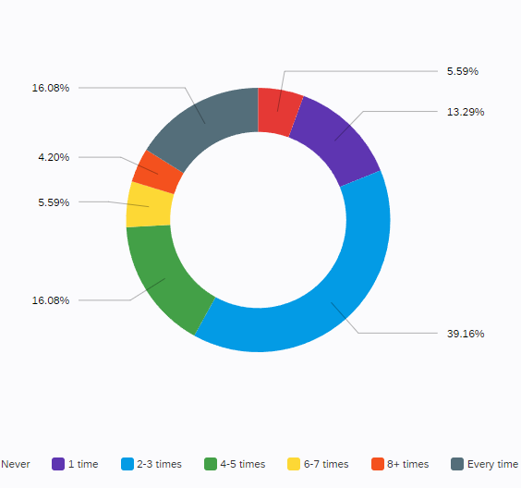
How Often Students Thrash Unfinished Food At NMU Dining Facilities

Slide 12
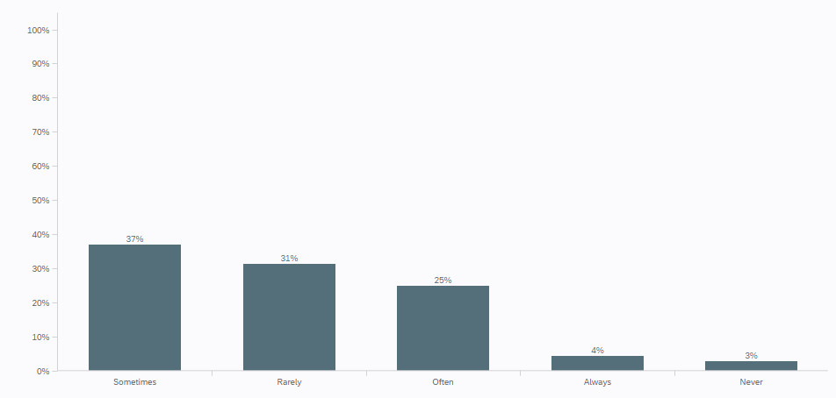
How Often Students Leave Uneaten Food When They Eat Alone At NMU Dining Facilities
NLD: Portion size and control - “You look across the dining hall, and you see people with a bowl with a bunch of food and one bite taken out of it...And then it is thrown away.” and ‘” it is weird to not be able to just pick and choose like a buffet”

Slide 13
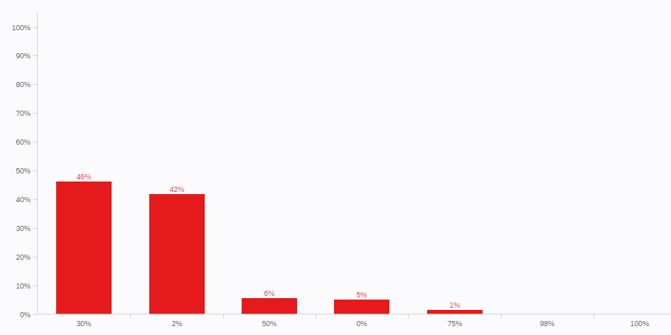
How Much Of Initial Food Usually Throw Into Trash

Slide 14
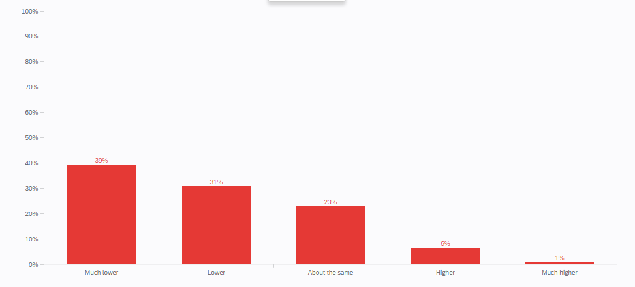
How Much Food Students Waste At Home Versus At NMU Dining Facility

Slide 15
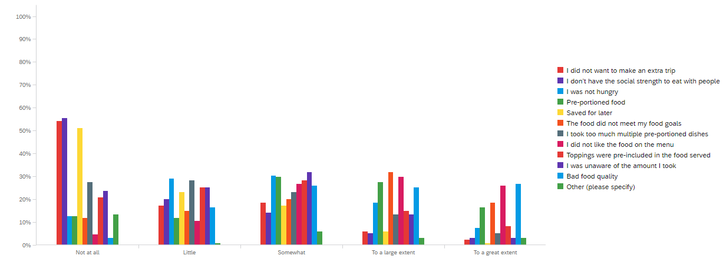
Reasons Students Do Not Finish Their Food At NMU Dining Facilities
Pre-plated foods: "If they put out, like four or five plates, that feel like awkward times in between, like lunch and dinner. They just sit there, and nobody even touches them. So, they will throw them away."

Slide 16
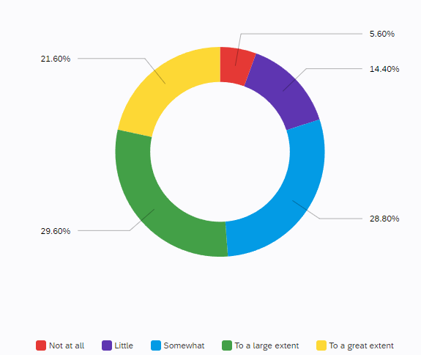
Awareness of NMU Dining Food Waste Diversion For Composting

Slide 17
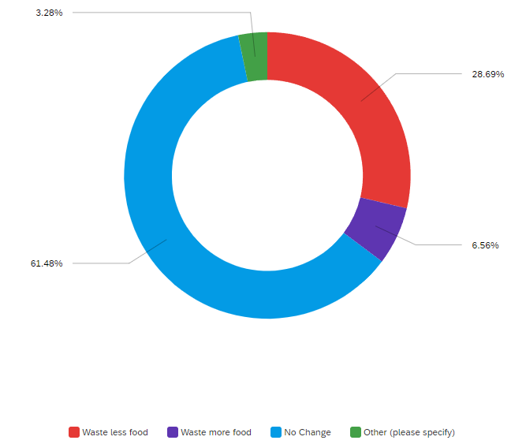
Whether Lack of Food Waste Diversion For Composting Affects Food-wasting Behavior

Slide 18
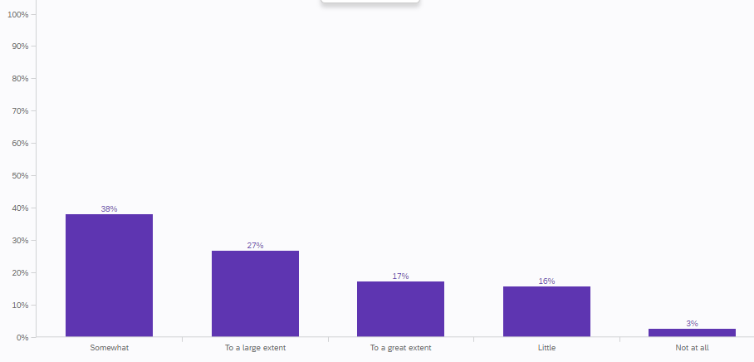
Whether Making Changes To Menu Planning Can Reduce Food Waste at NLD
Easier to overconsume and waste more
Students want to get their money's worth- “if I waste food, so what.”
Mindset ascribed to:
How much a meal plan costs
Wanting to get the most out of their plans

Slide 19
Whether Changing Service Methods Can Reduce Food Waste at NLD

Slide 20
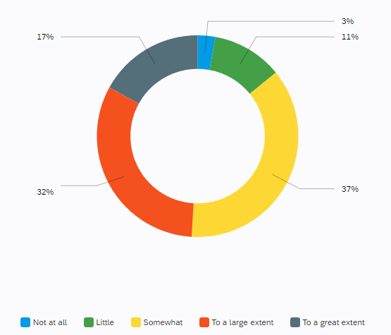
Educating Students to Reduce Food Waste

Slide 21
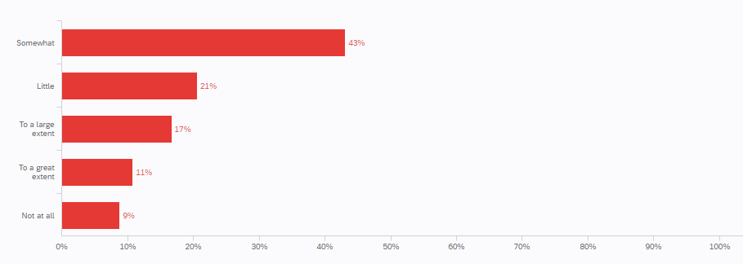
Not Pre-including Toppings to Reduce Food Waste

Slide 22
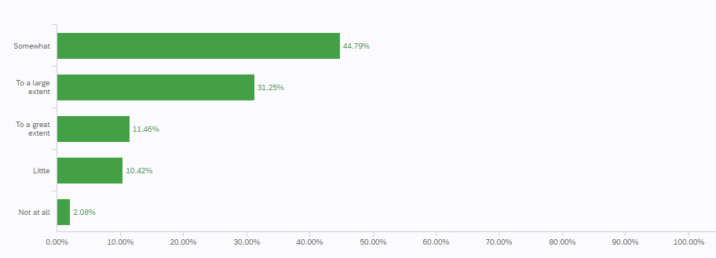
Changing To Prepare-As-Needed Topping Preparation to Reduce Food Waste

Slide 23
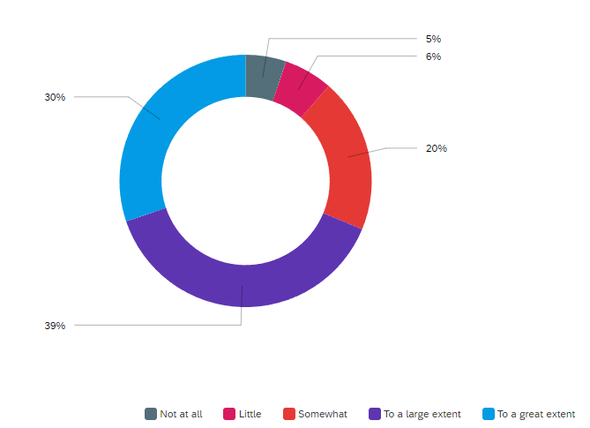
Implementing Reusable Containers to Reduce Food Waste

Slide 24
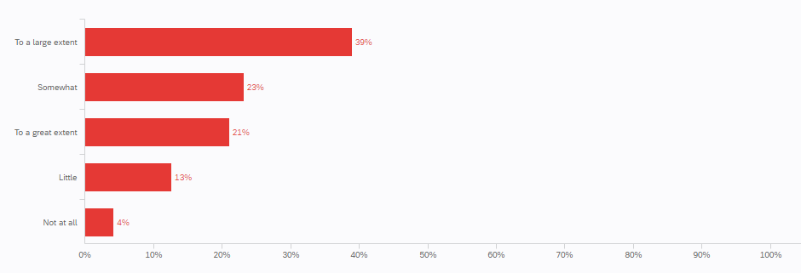
Implementing More Self-serve Stations to Reduce Food Waste
Pre-plated items:
Get cold and dry faster
Limits students to items they are familiar with
Risk of poor food quality
Portion sizes are often excessive

Slide 25
Conclusions
NMU to adopt several measures to address food waste
Food quality and variety improvements
Switch from pre-plated meals to buffet-style service
Introduce reusable container program for takeout
Integrate waste management education into the curriculum
Move away from no-carryout dining practices to more flexible and sustainable options
Food waste reduction education and integration into the curriculum

Slide 26
Thank You

